Slide 1
Software evolution
Session 01/08/2022
Location in the SDLC
Software Change
Evolution processes
Software evolution process
Questions
Change is inevitable

Slide 2
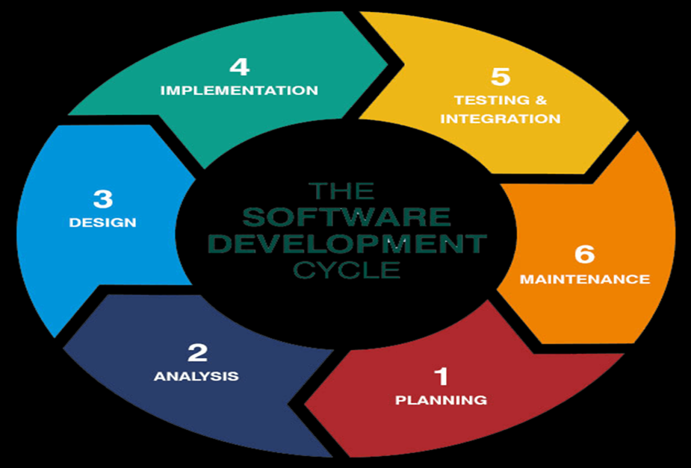
Location in the SDLC
Post-deployment
Remainder of life
Use and value

Slide 3
Software change
Why should software evolve?
Where did things go wrong?
Where can or will things go wrong?
How can we prevent things from going wrong?
Reasons
Importance
Cycles

Slide 4
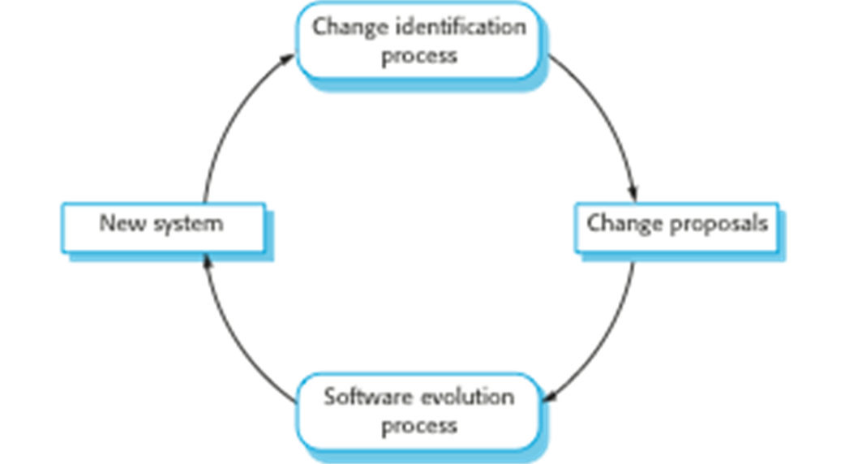
The processes
Planned or urgent
Agile
Handover problems

Slide 5
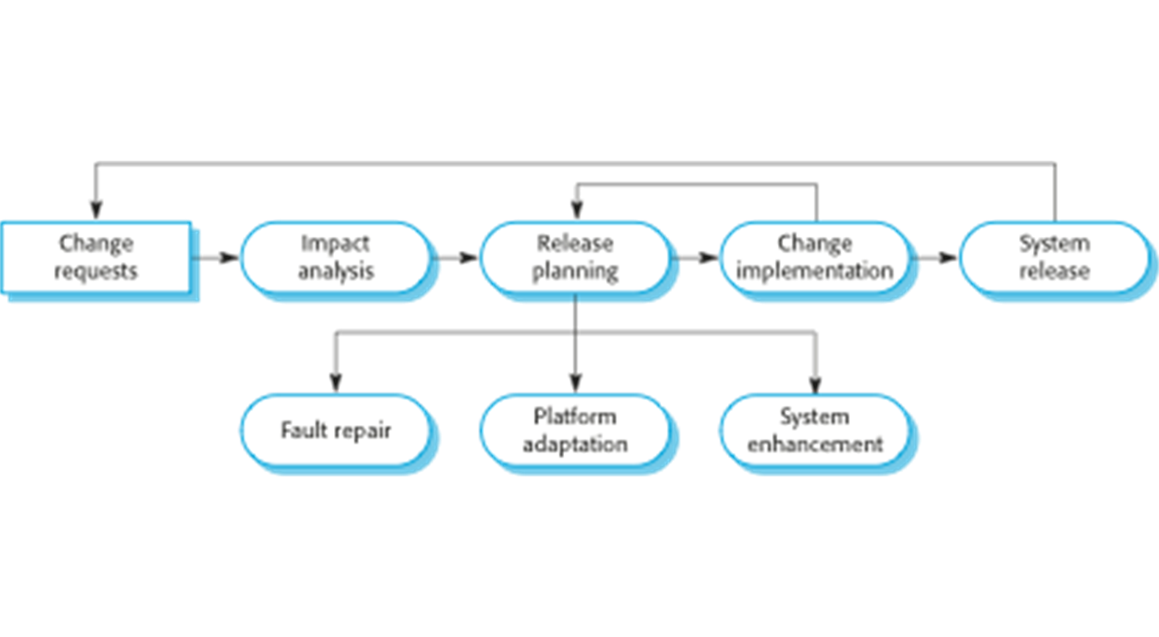
Software evolution process

Slide 6
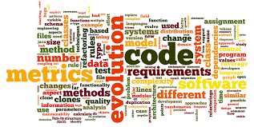
Dynamics of Program Evolution
Evolution vs Servicing
Phase out
Lehman’s Laws
Change is inevitable
Complexity increases, structure decreases
In large systems, evolution is controlled by organizational factors
Evolution is constant – not resource related
Rate at which new functionality can be introduced is limited

Slide 7
Today’s exercise
Which programs would need to evolve to ensure that the system is compliant with the requirements for operating within COVID-19 Lockdown 3 restrictions ?
How would the system(s) need to evolve?
What needs to evolve?
Answer the following questions based on the Restaurant System for the project assigned in Term 1 and determine

